Slide 1

IILM UNIVERSITY
School of Computer Science and Engineering
INTERNSHIP PRESENTATION
INTERNSHIP DETAILS
STUDENT
Shubh Jain
ENROLLMENT NO.
25SCS1003004430
MIS Operations & Data Reporting
PROGRAM
B.Tech (CSE)
SEMESTER
I
ORGANIZATION
AimTech Soft Pvt Ltd
DURATION
1 July – 30 July 2026
Remote Internship
Academic Session 2026–27
IILM University • Internship Presentation
01

Slide 2
Internship Overview
01
Role
Mode & Duration
Core Theme
MIS Executive Focused on data management, reporting, trackers and management information.
Remote internship 1 July 2026 to 30 July 2026 1 month
Bridging classroom knowledge of data handling with practical, industry-oriented MIS operations.
Internship Purpose
• Understand the role of MIS in business decision-making.
• Work through an end-to-end data reporting workflow.
• Convert raw operational data into structured, actionable information.
• Develop practical spreadsheet, reporting and coordination skills.
IILM University • Internship Presentation
02

Slide 3
Organization Profile
02
AimTech Soft Pvt Ltd
Technology-driven organization guided by the principle “Experience Certainty.”
Data & Reporting
Business Support
Internship Environment
Emphasis on reliable internal data governance and reporting practices.
MIS helps track performance, streamline operations and support data-driven decisions.
Remote, hands-on exposure to MIS operations, data management and reporting.
Role within the organization
The internship placed the student within an MIS workflow where accurate, timely information is prepared for team and management review.
IILM University • Internship Presentation
03

Slide 4
Problem Statement & Objectives
03
Problem Statement
Project Objectives
Organizations generate large volumes of operational data, but the data becomes useful only when it is accurately collected, organized and presented for timely decision-making. The internship addressed the practical challenge of consolidating scattered data into consistent, accurate reports and dashboards.
• Understand MIS and its importance. • Gain hands-on data collection and validation experience. • Organize and consolidate data using Excel and Google Sheets. • Prepare periodic MIS reports. • Build trackers and basic dashboards. • Use formulas, pivot tables and basic automation. • Coordinate with teams for accurate inputs.
IILM University • Internship Presentation
04

Slide 5
Scope of the Internship
04
01
Collect
02
Clean
03
Consolidate
Gather raw operational data from internal sources, sheets and team inputs.
Check errors, duplicates, gaps and inconsistencies.
Merge validated data into structured master spreadsheets.
04
Analyze
05
Report
06
Review
Use formulas and pivot tables to summarize trends and exceptions.
Prepare periodic MIS reports, trackers and basic dashboards.
Share outputs for feedback, correction and decision-making.
IILM University • Internship Presentation
05

Slide 6
Technologies, Tools & Techniques
05
MS Excel
Google Sheets
Formulas, VLOOKUP/XLOOKUP, Pivot Tables, conditional formatting
Collaborative spreadsheet-based data organization and reporting
Data Management
Dashboards
Cleaning, validation, consolidation and structured master data
MIS templates, trackers and basic dashboard creation
Basic Automation
Communication
Excel formulas and macros for repetitive reporting tasks
Email and messaging tools for remote coordination
Key capability developed: turning raw data into structured information that is easier to review and act upon.
IILM University • Internship Presentation
06

Slide 7
Methodology & Work Process
06
1
2
3
4
5
6
Orientation
Data Collection
Validation
Reporting
Coordination
Finalization
Onboarding, reporting formats, tools and MIS responsibilities.
Gathering assigned data and entering it into structured formats.
Checking errors, duplicates and inconsistencies.
Using formulas and pivot tables to prepare reports and dashboards.
Resolving data gaps and incorporating team feedback.
Ensuring accuracy and submitting reports for review.
Continuous review and feedback were incorporated throughout the internship to improve accuracy and presentation.
IILM University • Internship Presentation
07

Slide 8
Learning Outcomes & Skills Gained
07
Technical & Analytical
Professional & Workplace
• Practical understanding of MIS in business decision-making
• Hands-on data collection, validation and consolidation
• Independent preparation of periodic MIS reports
• Basic dashboard and tracker creation
• Improved Excel / Google Sheets proficiency
• Formulas, pivot tables and conditional formatting
• Better remote coordination and communication
• Readiness for entry-level MIS / data reporting responsibilities
Overall outcome: a completed industry internship demonstrating practical MIS and data-reporting capability.
IILM University • Internship Presentation
08

Slide 9
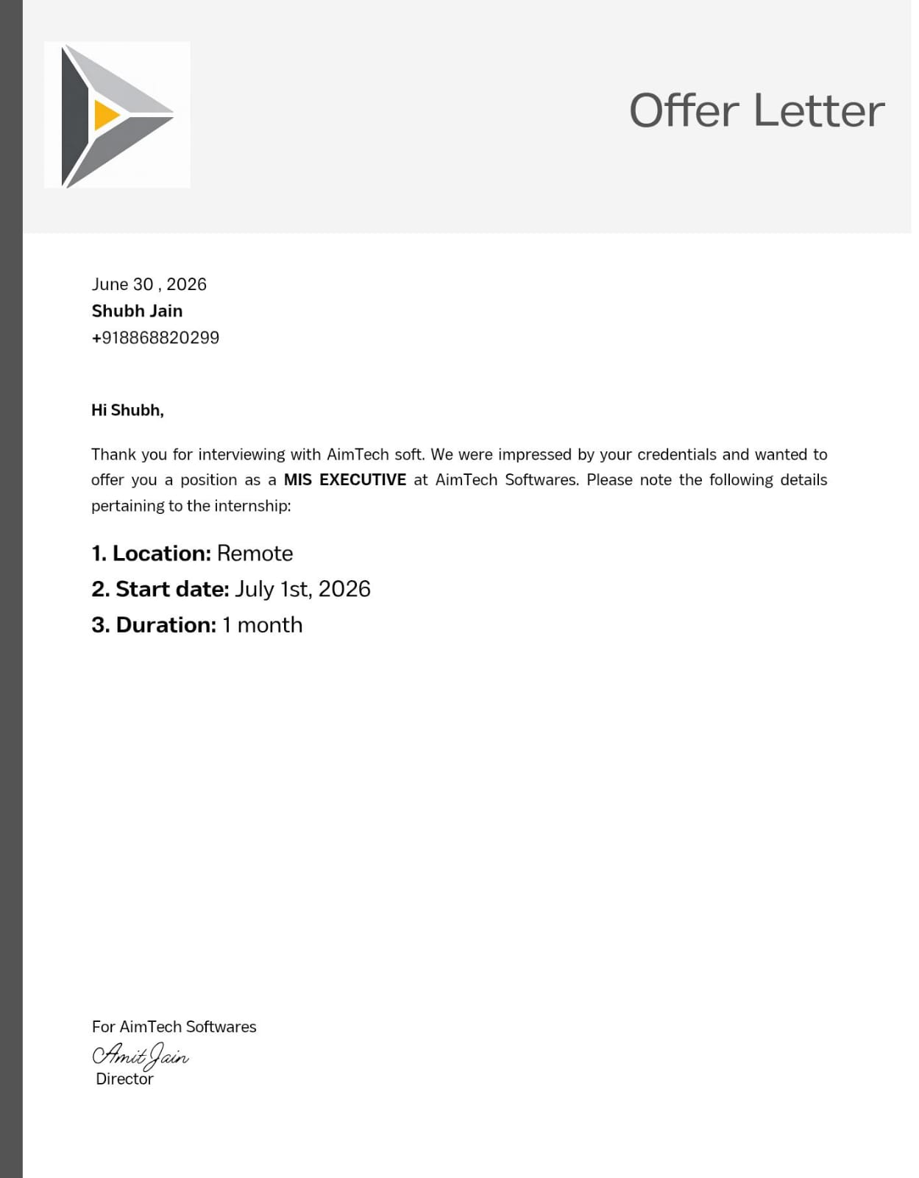
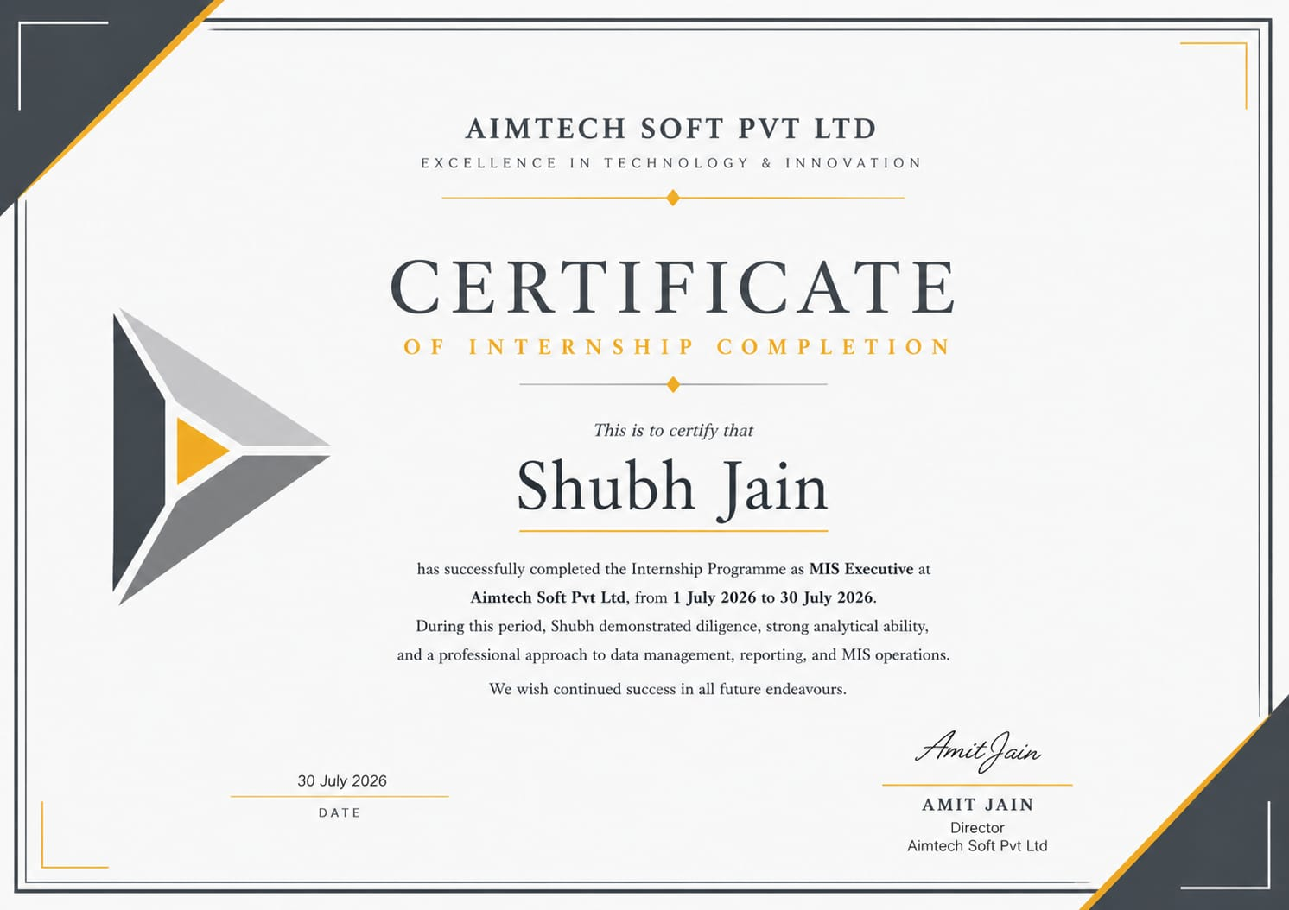
Internship Documentation
08
Offer Letter
Completion Certificate
Issued by AimTech Soft Pvt Ltd • MIS Executive • 1 July–30 July 2026
IILM University • Internship Presentation
09

Slide 10
Thank You
Internship Presentation — MIS Operations & Data Reporting
Shubh Jain • 25SCS1003004430 • B.Tech (CSE)
IILM University, Greater Noida
A practical journey from raw data to reliable management information.
IILM University • Internship Presentation
10

